Slide 1
Implementing Plain Language Emergency Alerts: An Evidence-Based Practice Project at Claremore Indian Hospital

Slide 2
Evidence Based-Practice Project completed by:
Mandy Anderson, RN
Mardell Nichols, RN, BSN
Eugenio Orona, RN
In partnership with the Claremore Indian Hospital

Slide 3
University of Mary Graduate Nursing Team
Mandy Anderson, RN
•Women’s Health Nurse Manager for Indian Health Service- Claremore Service Unit ( Claremore Indian Hospital)
•14 years of nursing experience primarily in Women’s Health
•5 years of managerial experience with the Indian Health Service
•Active member in the AWHONN, ANA, and involved with the Oklahoma Perinatal Quality Improvement Collaborative (OQPIC).
•Instructor of Advanced Life Support of Obstetrics (ALSO)

Slide 4
University of Mary Graduate Nursing Team
Mardell Nichols, RN, BSN
Director of Nursing for the Northern Cheyenne Service Unit, Lame Deer, MT
1999 BSN graduate of the University of Mary
14 years of ICU and ED nursing experience
12 years of Managerial/Supervisory experience with the Indian Health Service

Slide 5
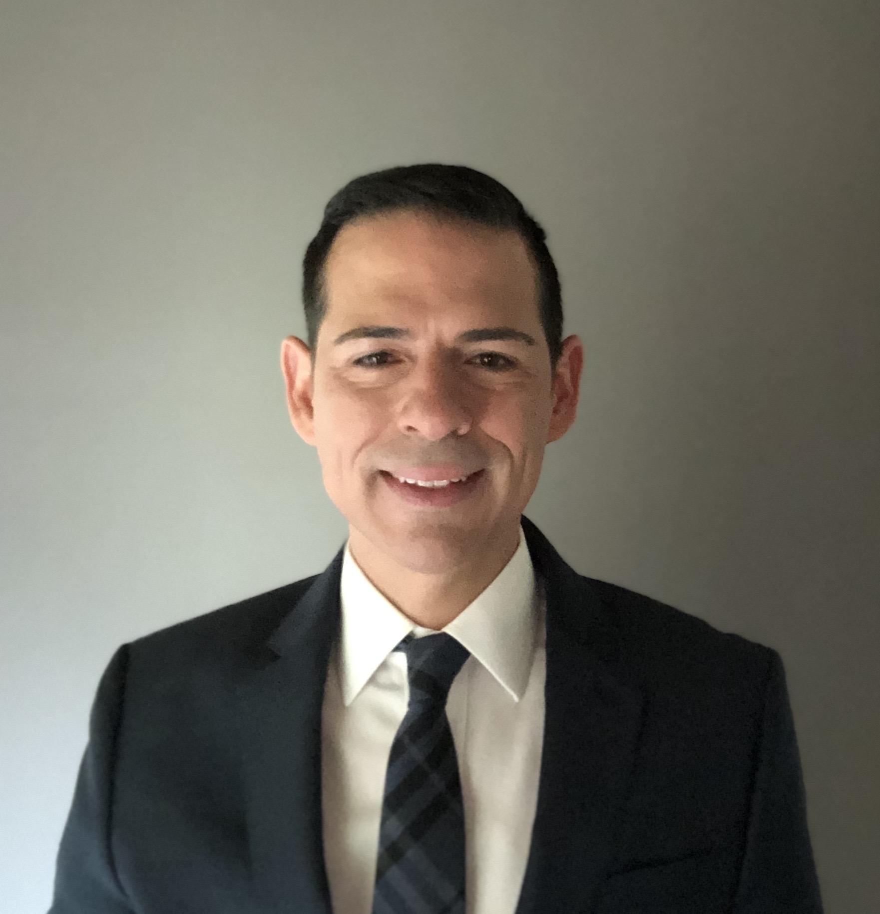
University of Mary Graduate Nursing Team
Eugenio Orona Jr., RN, BSN
Travel ICU nurse with Aya Healthcare
2007 BSBA graduate of Drexel University
2020 BSN graduate of Cedar Crest College
12 years of Marketing Executive experience
3 years of nursing experience including traveling in CVICU, MICU, TICU, SICU, and BMT

Slide 6
Acknowledgements
The University of Mary Graduate Nursing Team would like to sincerely thank:
The Claremore Indian Hospital for their cooperation in this evidence-based practice endeavor
Alonna Adair, RN, MSN – Chief Nurse Executive and mentor for the graduate nursing team
Faculty Advisor Claudia Dietrich, RN, MSN, BC-NE for her leadership and guidance through this EBP project

Slide 7
Problem Identification
Background
Problem Statement
Significance of Clinical Problem
PICOT Question
Purpose Statement

Slide 8
Background of Problem
Emergency codes are used in hospitals throughout the United States and worldwide with the universal intent of relaying emergent information.
Emergency alert code systems are, however, only as effective as the healthcare workers are familiar with the code system (Prickett & Williams-Prickett, 2018).
On September 14, 1999, a shooting occurred at the West Anaheim Medical Center; the hospital announced “Code Gray,” the hospital’s code for an aggressive patient. This alert drew staff members toward the shooter, who ultimately killed three employees (Dauksewicz, 2018).

Slide 9
Claremore Indian Hospital has identified recent events of code confusion with employees not knowing if they are responding to an adult, pediatric, or neonate emergency.
Consequently, to many employees have responded resulting in disruption of life-sustaining interventions.
A secondary problem identified was code activators struggled with calling an emergency code in a way that would alert the correct response team resulting in delays of life saving interventions. Depending on the situation, this also has the potential to put employees in danger similar to the West Anaheim Medical Center incident.

Slide 10
Claremore Indian Hospital has identified recent events of code confusion with employees not knowing if they are responding to an adult, pediatric, or neonate emergency.
Consequently, to many employees have responded resulting in disruption of life-sustaining interventions.
A secondary problem identified was code activators struggled with calling an emergency code in a way that would alert the correct response team resulting in delays of life saving interventions. Depending on the situation, this also has the potential to put employees in danger similar to the West Anaheim Medical Center incident.

Slide 11
PICO(T) Question
In healthcare workers in the Labor and Delivery unit at Claremore Indian Hospital (P), how would implementing plain language emergency codes (“medical emergency + Descriptor + Location”) (I), compared to color emergency codes (“code blue”) (C), improve response times and employee knowledge (O) in three months (T).

Slide 12
Problem Statement
Claremore Indian Hospital currently uses color-coded emergency alerts. Clarity of who should respond and which specialty is needed leaves employees confused thus delaying response times.

Slide 13
Purpose Statement
The purpose of this project is to examine whether using plain language emergency alerts reduces provider response times and code confusion and how to implement it within Claremore Indian Hospital.

Slide 14
Review of Literature

Slide 15
Literature Themes
Three Common Literature Themes
Support for plain language over code standardization
There is a difference between plain language and code standardization
Code: refers to colors, numbers, or keywords “Code Gray,” “Code 12,” or “Code Manpower” all could have different meanings in different organizations
Example of Plain Language: “security assistance + location + action required”
Many federal agencies, hospital associations, and regulatory bodies support the use of plain language: National Incident Management System (NIMS), Federal Emergency Management Agency (FEMA), Department of Health and Human Services (DHHS), ten state Hospital Associations, the Joint Commission, and the Centers for Medicare & Medicaid Services (CMS).
(Harris et al., 2022)

Slide 16
Literature Themes
Support for plain Language over code standardization
Standardization
vs.
Plain Language
Code: refers to color, number, or keyword
Codes could have different meanings in different organizations
Plain language example: “security assistance + location + action required”
Support from regulatory agencies: Institute of Medicine
TJC
CMS

Slide 17
Literature Themes
Code confusion
Emergency codes are often developed independently be each hospital, leading to variability and code confusion.
A study in Pennsylvania found that 80 codes in 37 categories were used across PA healthcare facilities. These codes were used in 154 combinations of terminology and intended meanings.
Many healthcare workers are employed in more than one facility and at least 75% of hospitals utilize temporary or agency nurses, this inconsistency in staffing also leads to confusion.
Natural disasters, active shooter situations, and terrorist attacks trigger multiagency and multidisciplinary responses. Thus, requiring police, fire, EMS, FEMA, and hospitals work together.
(Prickett & Williams-Prickett, 2018; also see Dauksewicz, 2018; Harris et al., 2022; Winger, 2022).

Slide 18
Literature Themes
Privacy and Ethics
Patients and visitors are even more vulnerable to confusion, fear, and anxiety when hospitals use codes. It removes any situational awareness.
Current research suggests that plain language codes could reduce uncertainty and anxiety by reducing the fear of the unknown.
Plain language alerts do not violate HIPPA, as these alerts do not include any of the 28 identifiers
HIPAA even allows for identifiers to be included in communications in the case of an emergency
(Carleton, 2016; also see Omori et al., 2017; Weikel, 2017)

Slide 20
Project Recommendations

Slide 21
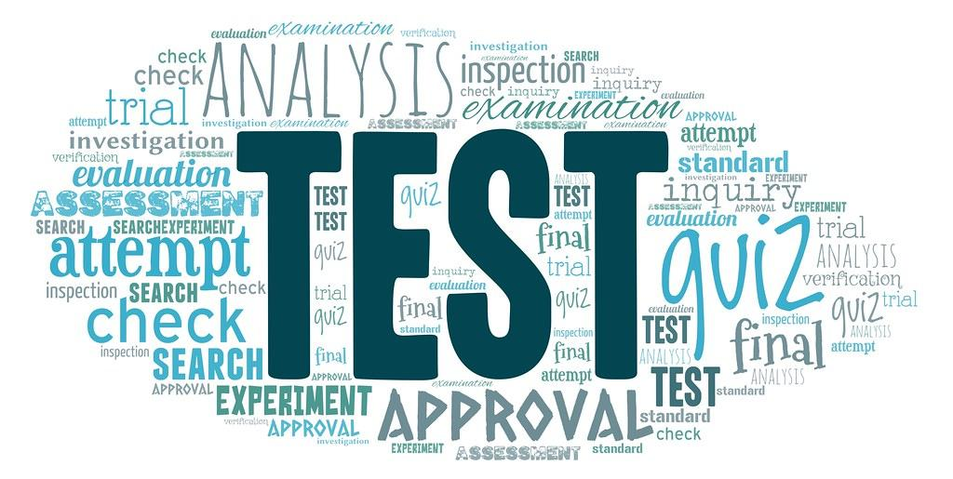
Recommendation 1
Assessing Knowledge and Educating
Standardized plain language terms
Assessing knowledge
Interviews
Questionnaires
Identify gaps
Assess knowledge
Education
Testing

Slide 22
Recommendation 2
Training and Re-assessing knowledge
Drills - Safety bundles
New hires - Orientation
Annual Simulations
Re-assessing knowledge
Testing
Roles during a drill
Actions taken
Simulation of mock plain language emergency alert

Slide 23
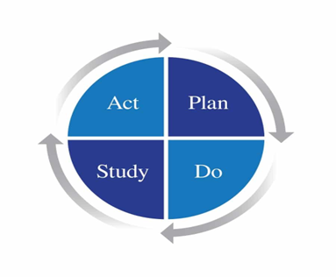
Implementation Plan
Claremore Indian Hospital utilitzes the PDSA method to implement quality improvement initiatives.
PDSA method is an ongoing cycle for improvement within organizations to test change.
(Plan-do-study-act (Pdsa) Directions and Examples, 2020)

Slide 24
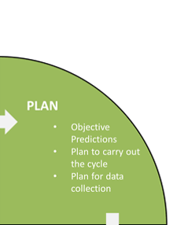
Step 1 Plan
Create a team
Labor & Delivery nursing staff
Respiratory Therapy
Pharmacist
Organizational Leadership
UMary Student Team
Collect data to analyze current response time/knowledge of staff
Develop Aim Statements/ Goals
All staff will be knowledgeable in Neonatal Code Team roles and responsibilities by February 1, 2023.
All (100%) Neonatal Code Team staff will respond to neonatal codes within 5 minutes or less by April 28, 2023.

Slide 25
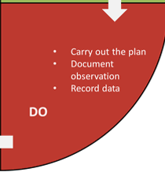
Step 2- Do
Implement Action Plan
●Develop sound structured policy and procedure
Code named Medical Alert-Neonate-Room #
● Policy review and acknowledgement by all staff
Verify supplies needed/ certifications of staff on response team
● Educate staff
Test skills of response team
Drill to test response and actions
Note any unexpected events or problems with plan

Slide 26
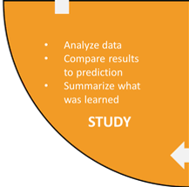
Step 3- Study
Gather data from responses since implementation
Re-interview staff for role and responsibilities
Review and evaluate the improvement

Slide 27
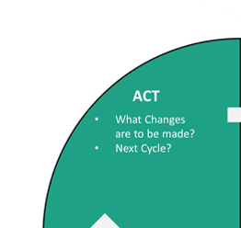
Step 4- Act
Reflect on the outcomes
■Success; standardize improvement
■Failed; develop a new plan and start at step 1

Slide 28
Measurement Plan
Data Reporting
Labor and Delivery Nurse Manager
Executive Leadership, Department Manager of Pharmacy, Respiratory Therapist, The Nursing Education Department, The Quality Department, The Safety Officer, and Security Team
Goals - 04/28/2023
Testing staff knowledge and skills in response times using plain language
Tracking times and debrief to identify areas of improvement
Team will respond within 5 min
Successful description of roles and responsibilities

Slide 29
Project Outcome Measurement
Policy and Procedure developed and approved
Departmental and Executive Leadership approved as of February 15,2023 for Medical Alert-Neonate
Policy review and acknowledgement by all staff as of March 31, 2023.
All radiant warmers have supplies needed for any resuscitation
Response Team staff have NRP certification

Slide 30
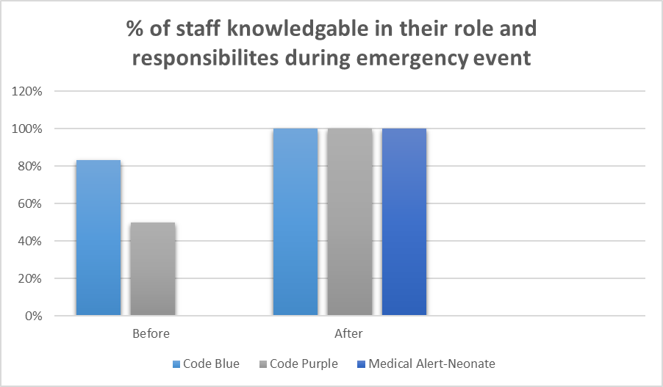
Outcome Measurement (cont.)

Slide 31
Project Implementation
Educate staff
Drills performed on March 13th and 23rd of 2023.
Notification of code “Medical Alert-Neonatal room #413”
Appropriate staff responded within 5 minutes
Staff using record form during code for medical record documentation
Staff able to verbalize and demonstrate appropriate responsibilities and roles during drills.
Additional drill schedule April 14, 2023

Slide 32
Analysis of Project Effectiveness
Response time within 5 minutes during drills of all team members
Re-interview staff for role and responsibilities
Staff interviews scheduled for April 14, 2023 after remaining drill
Standardize improvement
Process and Procedure successful as of yet,
Process will continue to drill to perfect process and procedure

Slide 33
Hand-Off Plan
Team & Hosp Meeting
Analyze and Review Data
Reduced response times
Known roles and responsibilities
Plan
Maintain Competency
Quarterly drills
Policies and Procedures
Certifications
Orientation of new employees
Expansion
Implementation onto other units
Safety Officers

Slide 34
Human Subject Protection Statement
International Review Board (IRB)
Application Process
Sent to Dr. Jenna Herman for review and signature
IRB Decision - January 17, 2023
Does not meet the human subject protection definition under 45 CFR 46
Does not have oversight authority
Project is able to proceed

Slide 35
Business Plan
Mission
Provide Education
Nurse Educator
Collaboration with multidisciplinary team and nursing staff
Execute Drills
Reduce response times
Perform quarterly drills
Potential Growth
Implement system throughout hospital
Replacing all color-coding system at Claremore

Slide 36
Business Plan Cont
Market Analysis
12 states advocate using new system
Small % in US use plain language alerts
Competition
Oklahoma hospitals use color-code system
Claremore Indian Hospital
Will be 1st in OK to use new system

Slide 37
Business Plan Cont.
Operational Plan
Structure
Claremore Indian Hosp
No structural changes
Human Resources
New-hire orientation
Future hiring needs
Budget
Educational costs
Interviews and questionnaires
Supplies and materials
Nursing, respiratory, and other multidisciplinary members
Training costs
Time
Resources

Slide 38
Conclusion
UMary Student Team
Identifying gaps
Providing recommendations
Having an implementation plan
Executing drills
Positive results
Reduce response times
Less confusion
Roles and Responsibilities

Slide 39
References
Carleton, R. (2016). Into the unknown: A review and synthesis of contemporary models
involving uncertainty. Journal of Anxiety Disorders, 39, 30–43.
https://doi.org/10.1016/j.janxdis.2016.02.007
Dauksewicz, B. W. (2018). Hospitals should replace emergency codes with pain language.
Journal of Healthcare Risk Management, 38(3), 32–41. https://doi.org/10.1002/jhrm.21346
Harris, C., Zerylnick, J., McCarthy, K., Fease, C., & Taylor, M. (2022). Breaking the code:
Considerations for effectively disseminating mass notifications in healthcare settings.
International Journal of Environmental Research and Public Health, 19(18). https://doi.org/10.3390/ijerph191811802
Joint Commission, 2022
Plan-do-study-act (pdsa) directions and examples. (2020). Agency for healthcare research and quality
https://www.ahrq.gov/health-literacy/improve/precautions/tool2b.html
Omori, H., Kuligowski, E. D., Butler, K. M., & Gwynne, S. M. (2017). Human response to
emergency communication: A review of guidance on alerts and warning messages for
emergencies in buildings. Fire Technology, 53, 1641–1668. https://doi.org/10.1007/s10694-017-0653-3

Slide 40
References
Prickett, K. J., & Williams-Prickett, K. (2018). Plain language emergency alert codes: The
importance of direct impact statements in hospital emergency alerts. Journal of Emergency Management, 16(2), 73–79. https://doi.org/10.5055/jem.2018.0356
Weikel, S. G. (2017). The ethics of using plain language in hospital emergency codes.
Journal of Healthcare Protection Management, 33(2), 94–105.
Winger, J. (2022). ENA position statement: Plain language emergency alerts.
Emergency Nurses Association. https://enau.ena.org/

Slide 41
Thank
You

